Slide 1
Eigenvalues and Eigenvectors
4.4 Eigenvectors and Linear Transformation
Bumhee Cho

Slide 2


The Matrix of a Linear Transformation
T
n
W
V
m
T(x)
x
ℝ^{n}
ℝ^{m}

Slide 3

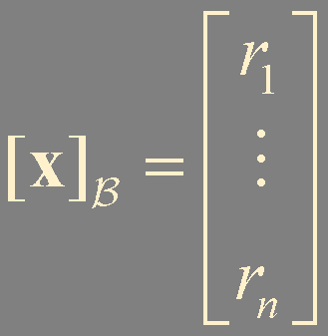
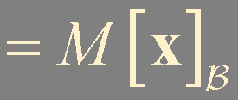

{b₁,… , b_{n}}
x = r₁b₁ + ⋯ + r_{n}b_{n}
T(x) = T(r₁b₁ + ⋯ + r_{n}b_{n})
= r₁T(b₁) + ⋯ + r_{n}T(b_{n})
matrix for T relative to the bases B and C

Slide 4
T
x
T(x)
M

Slide 5




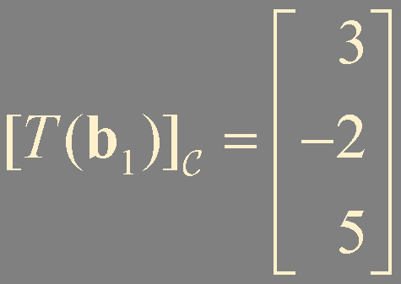
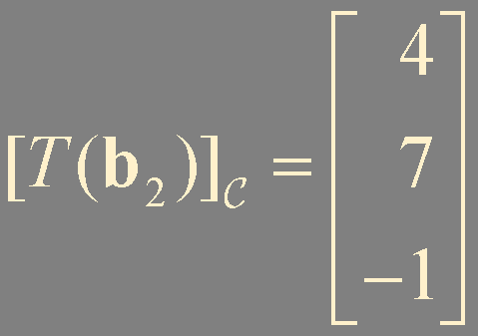
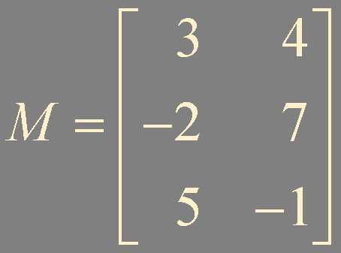
Example 1.

Slide 6
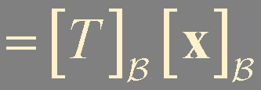


Linear Transformation from V into V
T
x
T(x)
matrix for T relative to the bases B
-matrix for T

Slide 7

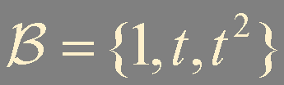
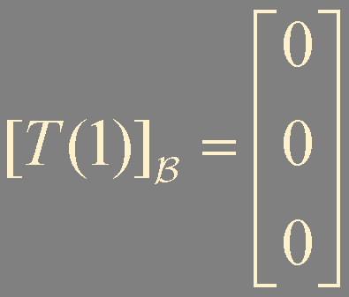
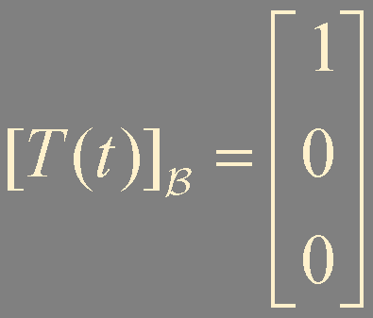
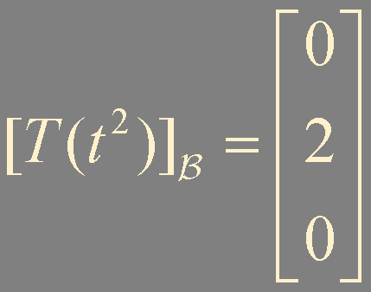
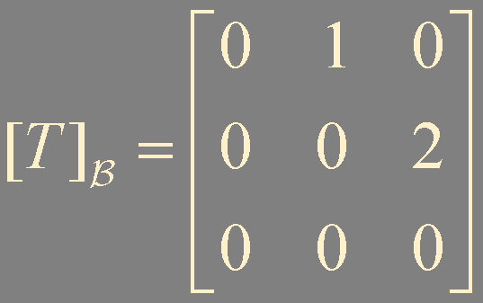
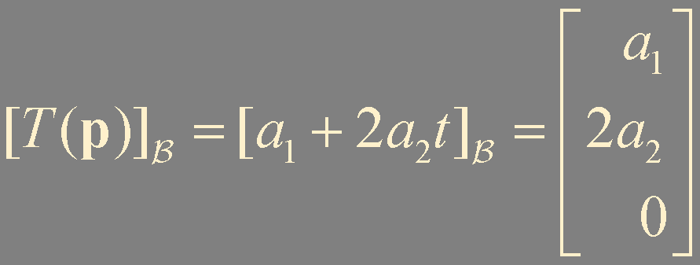
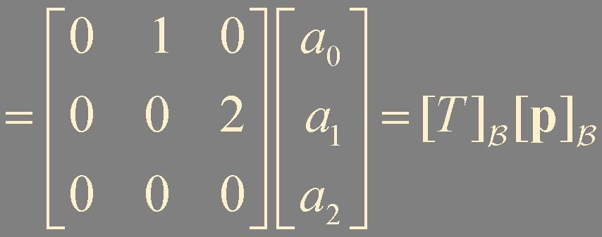
Example 2.
T : ℙ₂ ↦ ℙ₂
T(1) = 0
T(t) = 1
T(t²) = 2t

Slide 8

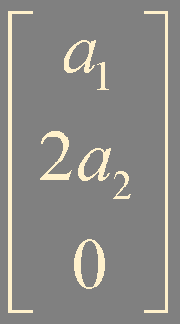

T
ℙ₂
ℙ₂
a₁+2a₂t
a₀+a₁t+a₁t²
ℝ³
ℝ³

Slide 9

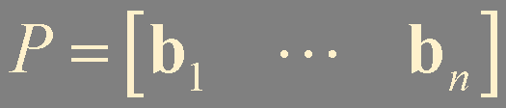

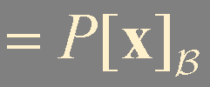
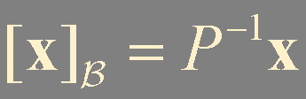

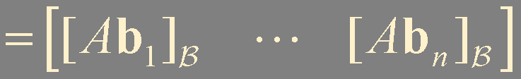
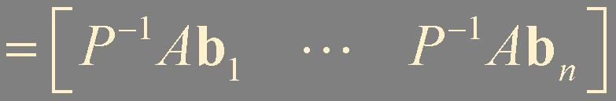
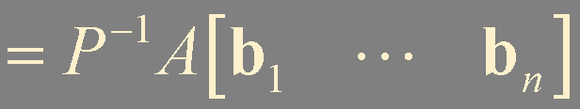


Linear Transformation on ℝ^{n}
Theorem 7. Diagonal Matrix Representation
Suppose A = PDP⁻¹, where D is a diagonal n × n matrix. If B is the basis for ℝ^{n} formed from the columns of P,
then D is the B-matrix for the transformation x ↦ Ax

Slide 10
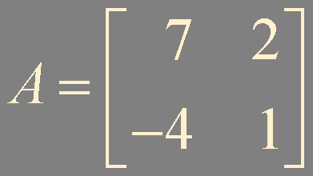
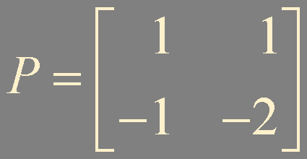
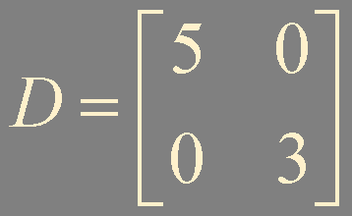
Example 3.
A
x
T(x)
P⁻¹
P
u
Du
D

Slide 11
Similarity of Matrix Representations
A = PDP⁻¹
A = PCP⁻¹
A
x
T(x)
P⁻¹
P
u
Cu
C

Slide 12
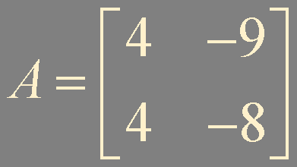
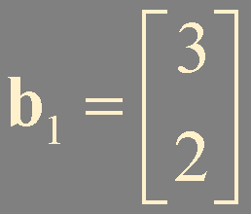
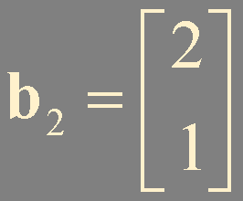


Example 4.
λ = -2 (multiplicity = 2)
eigenspace dimension = 1
not diagonalizable!

Slide 13
Summary
Linear transformation

